Slide 1
Introduction to NoSQL (MongoDB)
Lecture 18

Slide 2
RDBMS vs NoSQL
RDBMS
Relational databases works on structured data with clearly defined relationships.
NoSQL
A NoSQL database lets you build an application without having to define the schema making updations easier as data and requirement change.
NoSQL databases are designed to handle unstructured data (e.g., texts, social media posts, video, email)
Relational databases make you define your schema before you can add any data to the system.

Slide 3
RDBMS vs NoSQL (Cont.)
RDBMS
NoSQL
File has unorganized data like:
1001, ‘Ram’, 10,000, ‘Delhi’
‘Ram’ can be system’s RAM as well.
File System + Program = DBMS
Example:
Here, 1001 is ID not some lucky number,
‘Ram’ is ‘Name’ not system’s RAM. Thus, RDBMS has structured data.
ID | Name | Salary | Address
1001 | Ram | 10,000 | Delhi
1002 | Sham | 20,000 | Gurgaon
…. | … | … | …

Slide 4
RDBMS vs NoSQL (Cont.)
RDBMS
Relational databases typically are closed source
NoSQL
It’s much cheaper to scale a NoSQL database because you can add capacity by scaling out over cheap, commodity servers.
NoSQL databases are mostly open source
Relational databases require a single server to host your entire database. To scale, you need to buy a bigger, more expensive server.

Slide 5
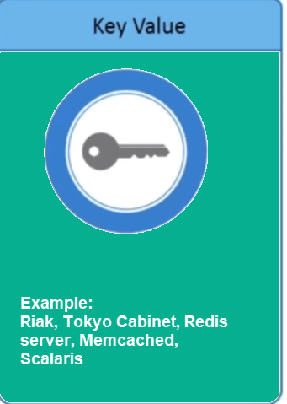
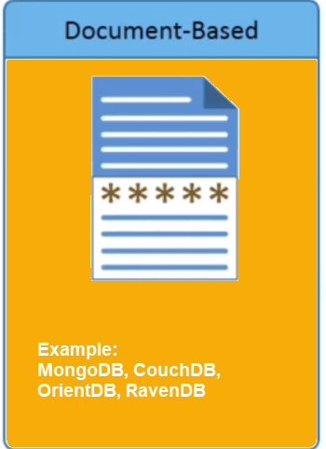
NoSQL Database Types
It has a Big Hash Table of keys & values
It stores documents made up of tagged elements

Slide 6
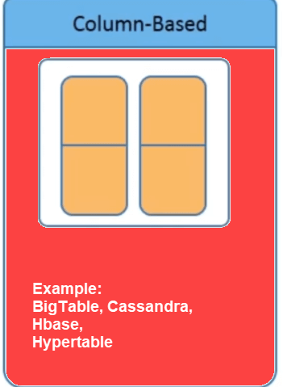
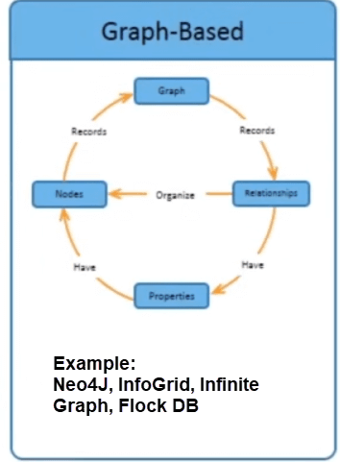
NoSQL Database Types (cont.)
A network database that uses edges and nodes to represent and store data
Each storage block contains data from only one column

Slide 7

Motivation for MongoDB
Problems with SQL
Rigid schema
Not easily scalable (designed for 90’s technology)
Requires unintuitive joins
Perks of MongoDB
Easy interface with common languages (Java, Javascript, PHP, etc.)
DB technology should run anywhere (VM’s, cloud, etc.)
Keeps essential features of RDBMS’s while learning from key-value NoSQL systems

Slide 8

Why Mongo DB?
All the modern applications deals with huge data.
Development with ease is possible with MongoDB.
Flexibility in deployment.
Rich Queries.
Older database systems may not be
compatible with the design.
It is a document oriented storage:- Data is
stored in the form of JSON Style.

Slide 9

Schema less database
Mongo Means Humongous (It can store lots of Data)
MongoDB is NoSQL Based DB
MongoDB
DataBase contains Collections.
Inside Collections we have Documents
Less Or No Relationships

Slide 10
Database is a physical container for collections
A single MongoDB server typically has multiple databases.
Collection is a group of MongoDB documents.
Documents within a collection can have different fields.
MongoDB
A document is a set of key-value pairs. Documents have dynamic schema. Dynamic schema means that documents in the same collection do not need to have the same set of fields or structure, and common fields in a collection's documents may hold different types of data.

Slide 11
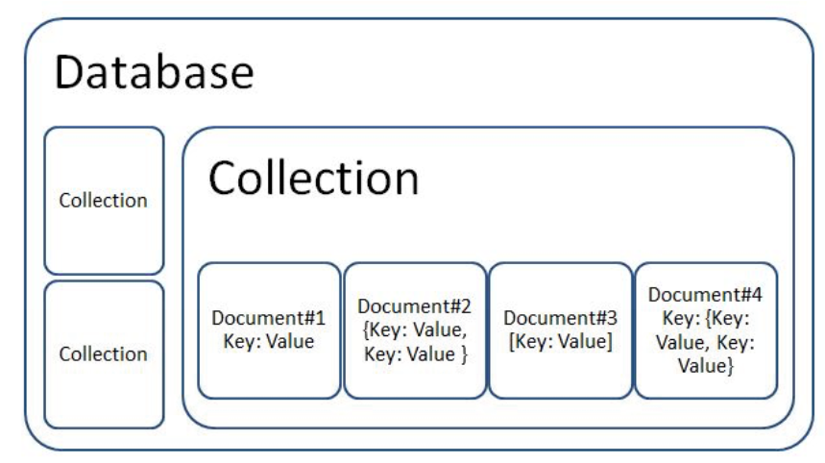

Slide 12
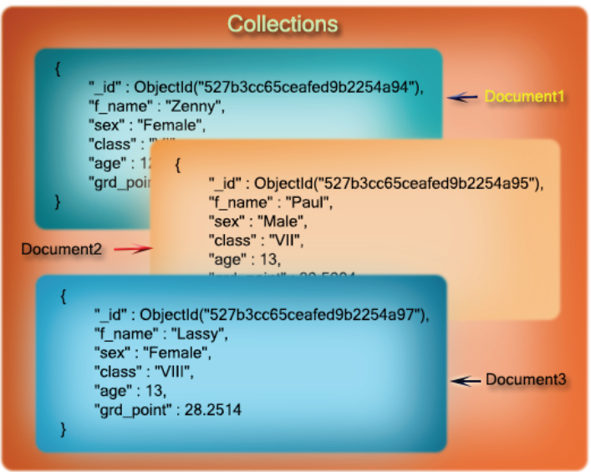

Slide 13
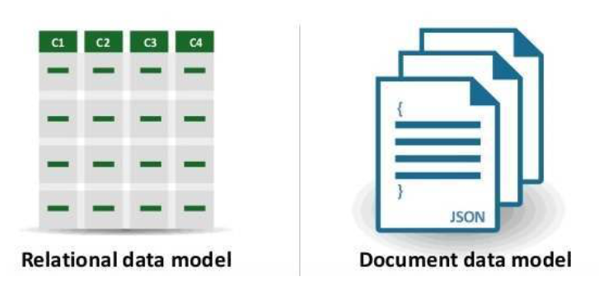
RDMS vs MongoDB

Slide 14
RDMS vs MongoDB (Cont.)
RDBMS
Relational database
Need to design your tables, data structure, relations first.
MongoDB
Non-relational and document-oriented database
You can start coding without worrying about tables and modify your objects at a lesser cost of development.
Supports SQL query language
Supports JSON query language
Table based
Collection based and key-value pair
Document based
Field based
Row based
Column based
Primary Key
Primary Key (Default key _id provided by MongoDB itself)
Contains schema which is predefined
Contains dynamic schema
Each row will have same number of columns
Each document can have different number of fields

Slide 15
JSON - JavaScript Object Notation
JSON is a syntax for storing and exchanging data. It can be nested/ embedded.
JSON is text, written with JavaScript object notation
When exchanging data between a browser and a server, the data can only be text.
JSON is text and any JavaScript object can be converted into JSON and then this JSON can be send to the server.
Example: {name: "John", age: 31, city: "New York"}
Key-value pairs

Slide 16
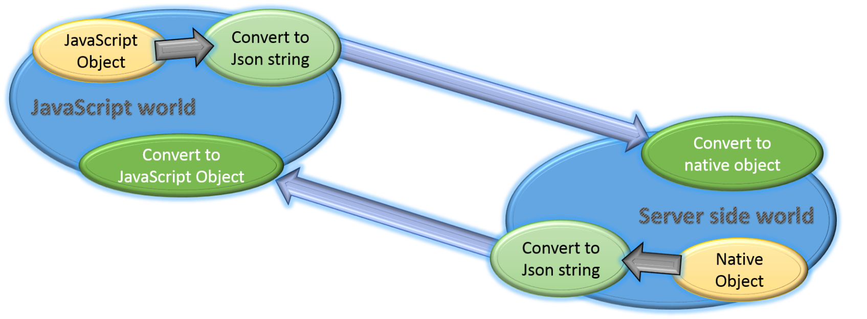
Why JS Object to JSON?
To transfer onto disk/ network
String
JSON
Life upto RAM
Refers memory
JS Object

Slide 17
JSON (cont.)
var myObj = {name: "John", age: 31, city: "New York"}
var myJSON = JSON.stringify(myObj)
Output: {"name":"John","age":30,"city":"New York"}
JSON.stringify()
JavaScript Object
JSON
Document
BSON
Text from web server: '{ "name":"John", "age":30, "city":"New York"}
var obj = JSON.parse('{ "name":"John", "age":30, "city":"New York"}');
Ouptput: {name: "John", age: 31, city: "New York"}
JSON.parse()

Slide 18
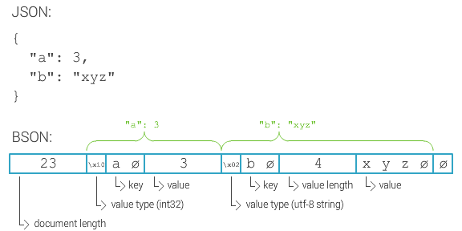
Data Storage in MongoDB
A document is a JSON in MongoDB.
Collection is a group of MongoDB documents (or JSONs).
MongoDB Store Data in form of BSON.
Maximum Size of Document in MongoDB is 16 MB Per Document.
Document contains JSON (as a Record) so Record Size is 16MB.

Slide 19

MongoDB Installation
Step 1 : Download the compatible version from
https://www.mongodb.com/download-center/community
Step 2: Install MongoDB through the interactive installation.

Slide 20
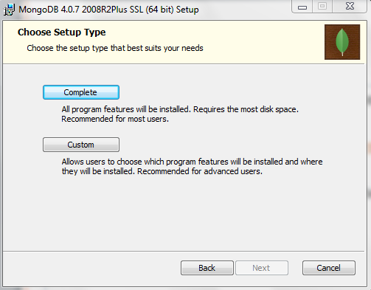
MongoDB Installation (cont.)
Step 3: Choose “Complete” Option

Slide 21
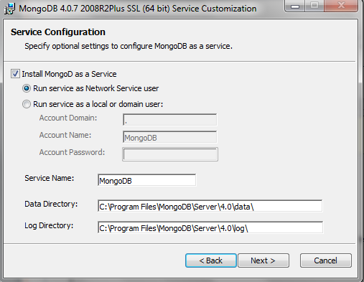
MongoDB Installation (cont.)
Step 4: Install MongoD as a service

Slide 22
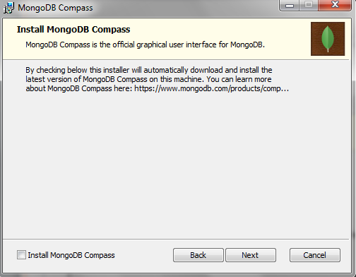
MongoDB Installation (cont.)
Step 5: Skip installing the “MongoDB Compass” which is a GUI for MongoDB

Slide 23
MongoDB Installation (cont.)
Step 6: Complete the installation process.
Step 7: The path variables are not updated by the MongoDB installer. To add the location to your path variable:
Go to “System Properties”, click on “Advanced System Settings” and then click “Environment Variables”.
Under “System Variables”, select “Path”, and then click “Edit”.
Add the path to your MongoDB bin folder. MongoDB is typically installed in C:\Program Files\MongoDB.
Be sure to add the leading semicolon (;) to indicate that you are adding a location to your PATH variable.

Slide 24

MongoDB Installation (cont.)
To check path has been installed properly or not, execute the following command in cmd:
mongod
Start Mongo Local Server
mongod –dbpath = <folder path>

Slide 25
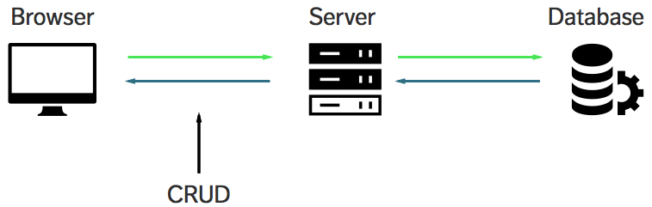
Running Mongo Client Shell
Open a new cmd
Run the following command
mongo

Slide 26
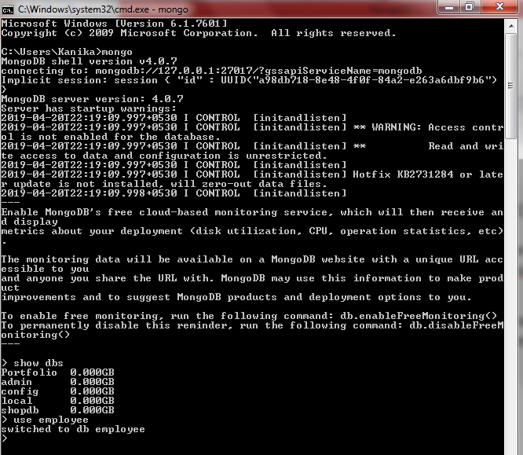
Working in the Mongo Shell
The mongo shell is an interactive JavaScript interface to MongoDB.
The mongo shell can be used to query and update data as well as perform administrative operations.

Slide 27

Create Database
use command: This command is used to create a database in MongoDB.
It will return an existing database or will create a new database if it dosen’t exist.
Syntax:
use DATABASE_NAME
Example:
> use company
Output: switched to db company

Slide 28

Create Database (cont.)
db command: to check currently selected database
Example:
> db
Output: company
show dbs command: to view databases list
Example:
> show dbs
Portfolio 0.000GB
admin 0.000GB
config 0.000GB
local 0.000GB
shopdb 0.000GB
The database “company” created is not visible in the list as no document is inserted into it yet.

Slide 29
Create Collection
createCollection( ) command: To create a collections in a database
Syntax:
db.createCollection(name, options)
Example:
> db.createCollection("employee")
Output: { "ok" : 1 }
Name of Collection
Options is a document and is used to specify configuration of collection i.e. options about memory size and indexing

Slide 30
Create Collection (cont.)
show collections command: To check created collections
Example:
> show collections
Output: department
employee
MongoDB creates collections automatically, when you insert some document.

Slide 31
Thanks!!

